Slide 1

Final Project
Xubing & Jiaxin
2025/12/17
Predicting NBA All-Star Selection Using Season-Level Player Statistics
Xubing Lai xl5178
Jiaxin Luo jl15566

Slide 2
Problem setup
Xubing & Jiaxin
DATE
Predict whether a player is selected as an NBA All-Star in a given season
Key Challenges
Strong class imbalance (≈20 All-Stars vs 500+ players)
Selection influenced by performance and non-performance factors
Team success，player popularity
subjective voting…
Binary classification problem
1 = All-Star
0 = Non–All-Star

Slide 3
Data Description
Name
DATE
Window Limiter
Data Source：Public Kaggle dataset with NBA box score statistics Structure
Game level data from 2023–2025
2023–24 season used for cross-season evaluation and application
Each row = one player’s performance in one game
Preprocessing
Aggregate to player season level using per-game averages
Features include: Points, assists, rebounds, Shooting percentages, Turnovers, Game Score

Slide 4
Models
Name
DATE
KNN
ANN
Window Limiter
Random Forest
Logistic Regression
Gradient Boosting
captures nonlinear relationships and feature interactions and achieves the best overall performance, making it the primary model used in this project.
predicts All-Star status based on similarity to other players but performs relatively worse due to high dimensionality and class imbalance
incrementally corrects prediction errors using sequential trees and performs competitively, though slightly below Random Forest.
provides a simple and interpretable baseline and performs strongly, showing that All-Star selection is largely driven by a few key performance metrics.
offers a flexible modeling approach but does not outperform tree-based models, consistent with common results on structured tabular data.

Slide 5
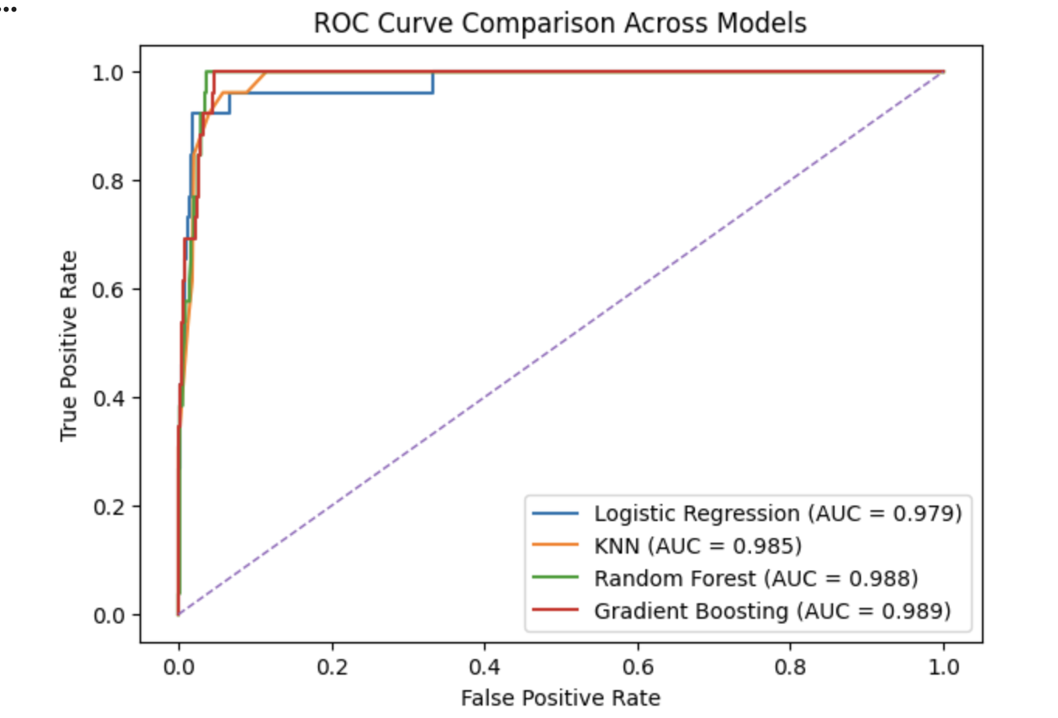
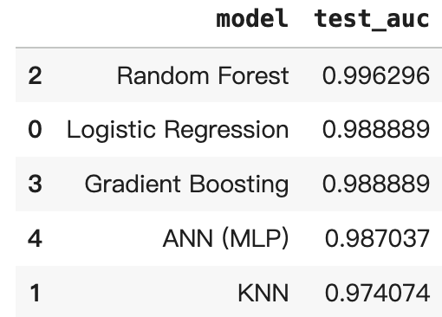
Results Evaluation
Xubing & Jiaxin
DATE
Why ANN didn’t meet expectations?
Evaluation Metric
ROC-AUC
Chosen due to severe class imbalance
Measures ranking quality, not exact selection
All models achieve high AUC
All-Star selection is strongly tied to performance statistics
Dataset limited in size
ROC-AUC measurement favors the ranking
Overall Performance
All models perform strongly
Random Forest performs best

Slide 6
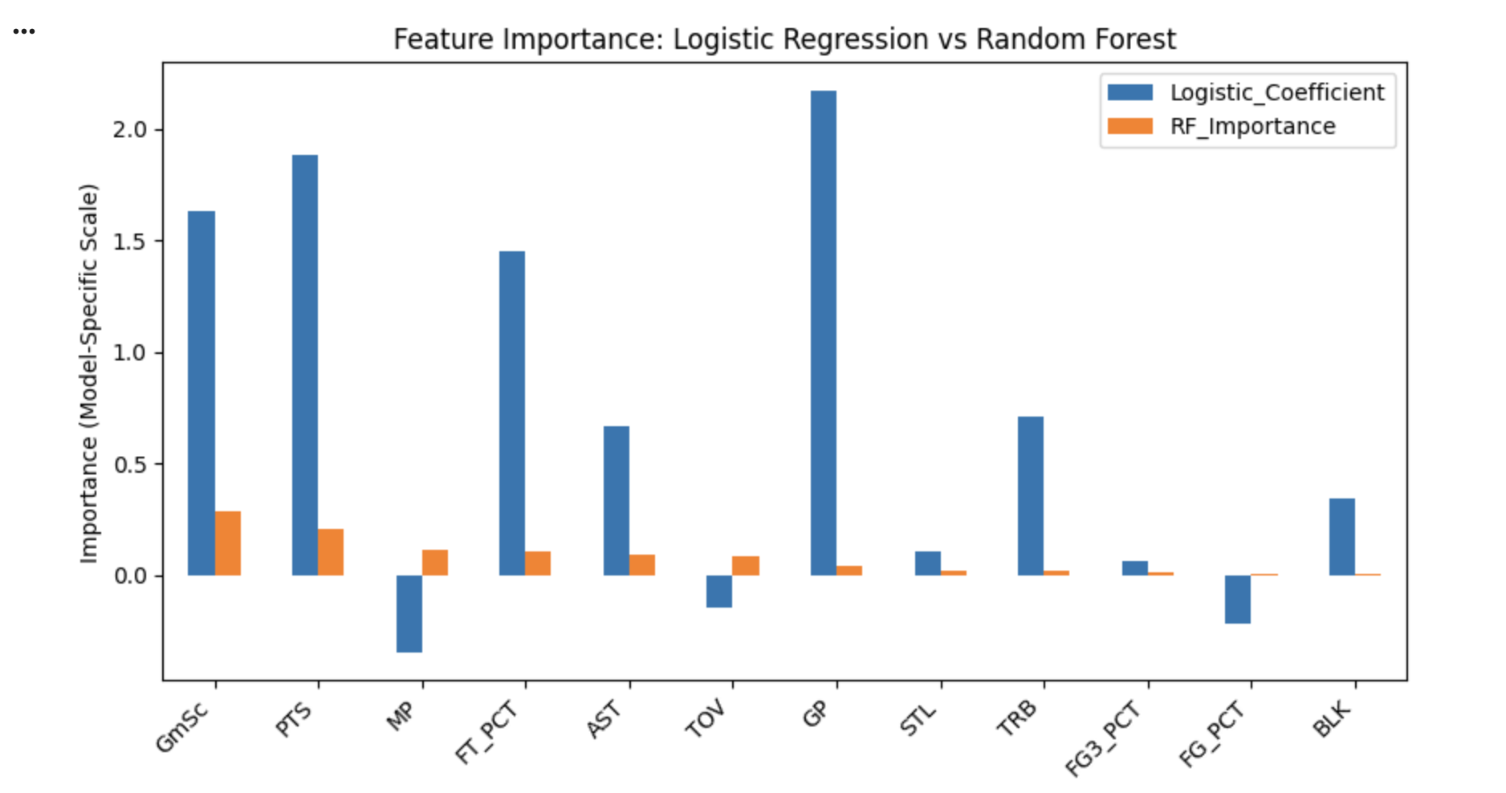
Why Random Forest Works Best?
Name
DATE
Window Limiter
All-Star selection depends on combinations of factors
Scoring
Playing time
Efficiency
Random Forest captures:
Nonlinear effects
Feature interactions
More data-efficient than neural networks on tabular data
Linear signals are strong, but nonlinear structure adds value

Slide 7

Cross-Season Evaluation
Name
DATE
Window Limiter
Setup
Train on 2024–25 season Test on 2023–24 season
Result
ROC-AUC ≈ 0.988
Interpretation
Slight drop, but still very strong
Model generalizes across seasons Captures stable selection patterns, not noise

Slide 8
Practical Application
Name
DATE
Window Limiter
Ranking Players
Apply the trained Random Forest model to rank 2023–24 players by All-Star probability
Focus on ranking candidates rather than strict binary classification
Model identifies most true All-Stars with highly reliable probability scores、
Error Analysis
False positives: injuries, limited games, team context
False negatives: player popularity, fan voting, team success
High-probability non-selections are due to factors beyond box score data, not model weakness
Overall, the model captures the statistical basis of All-Star selection
Best interpreted as a data-driven ranking and decision-support tool

Slide 9
Conclusion & Next Steps
Name
DATE
Window Limiter
Conclusion
NBA All-Star selection can be predicted by our model with high accuracy
Random Forest performs best and generalizes well
Selection involves factors beyond performance alone
Future Work
Train on multiple seasons
Add advanced or team-level metrics
Evaluate in a forward-looking prediction setting

Slide 10
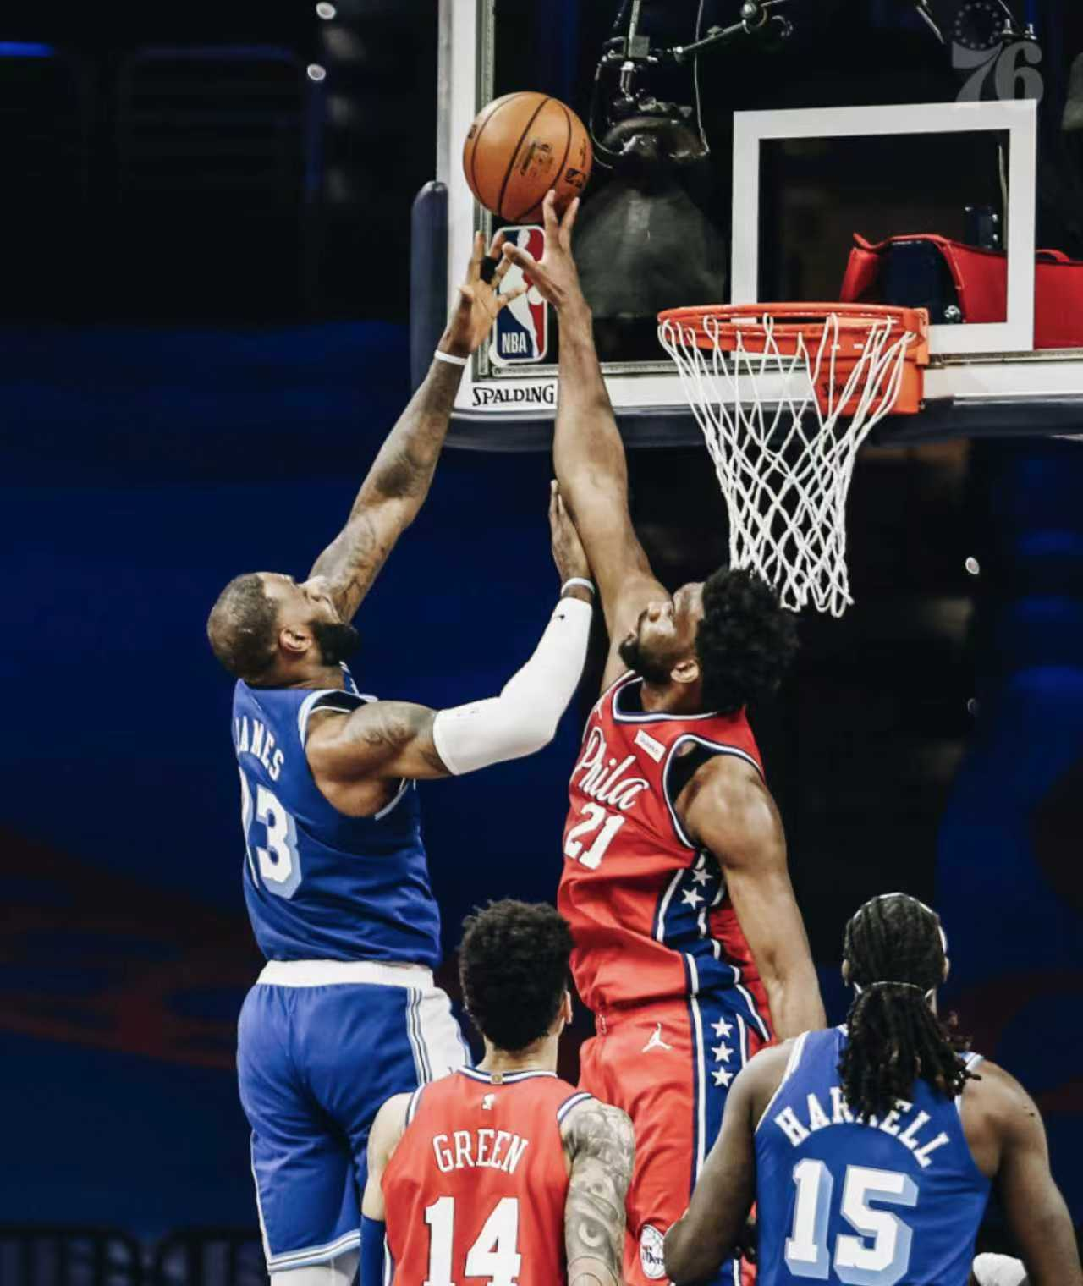
Thanks for listening!
Xubing Lai
Jiaxin Luo

